Slide 1


Introduction to Software Development
Week 2 Day 3
Led by: Emily Crose
for
Oakland University

Slide 2
Last Session Recap

Slide 3

Questions From The Last Session?

Slide 4
Terms To Listen For
Principal of least privilege
When the least possible amount of privilege is given to any network device or user for the to be able to safely and successfully do their job
Topology
A layout or map of a network
’Air-gapped’ network
A network with no external connections or dependencies

Slide 5

Separation of Duties

Slide 6

Separation Of Duties
Worker separation of duties
Who is assigned to do what on the team
Network separation of duties (engineering)
Which devices do what on the network
Notes:
Today we’re going to talk about engineering

Slide 7
Why is this important?
Increases efficiency
Increases security

Slide 8
Principle of Least Privilege
No individual, group, or device should be given any more privileges than it needs!

Slide 9

Network Topology

Slide 10
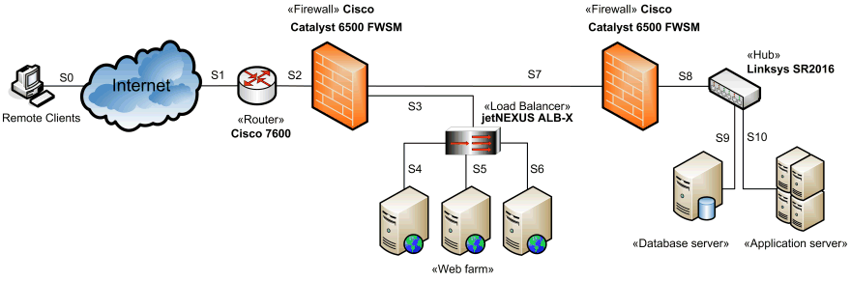
Network Topology
Notes:
Let’s revisit our networking session from last week and take a look at a network topology. What do we see here in this network architecture diagram? We see a networking separation of duties. The lesson we learn from this network topology is that working with a separation of duties in how we architect our networks and services keeps things clean, and it keeps things safe. This is a well architected network with a good separation of duties.
What we could use is a framework that will help guide our decisions about how to separate these devices.

Slide 11

Purdue Model Explained

Slide 12

Purdue Model, What Is It?
A method of arranging and segmenting networked operational technology (OT) devices.

Slide 13
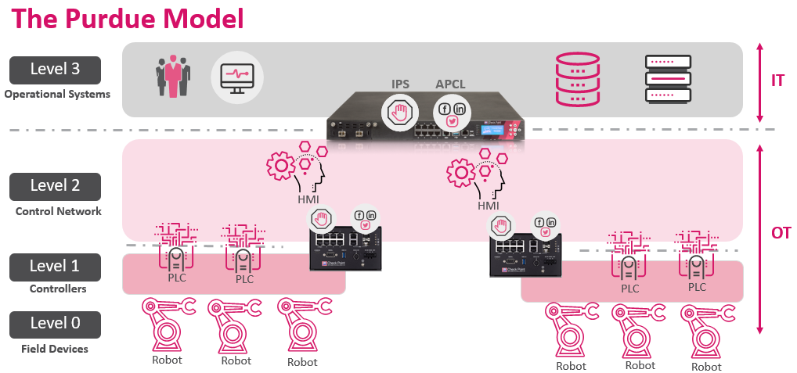

Slide 14
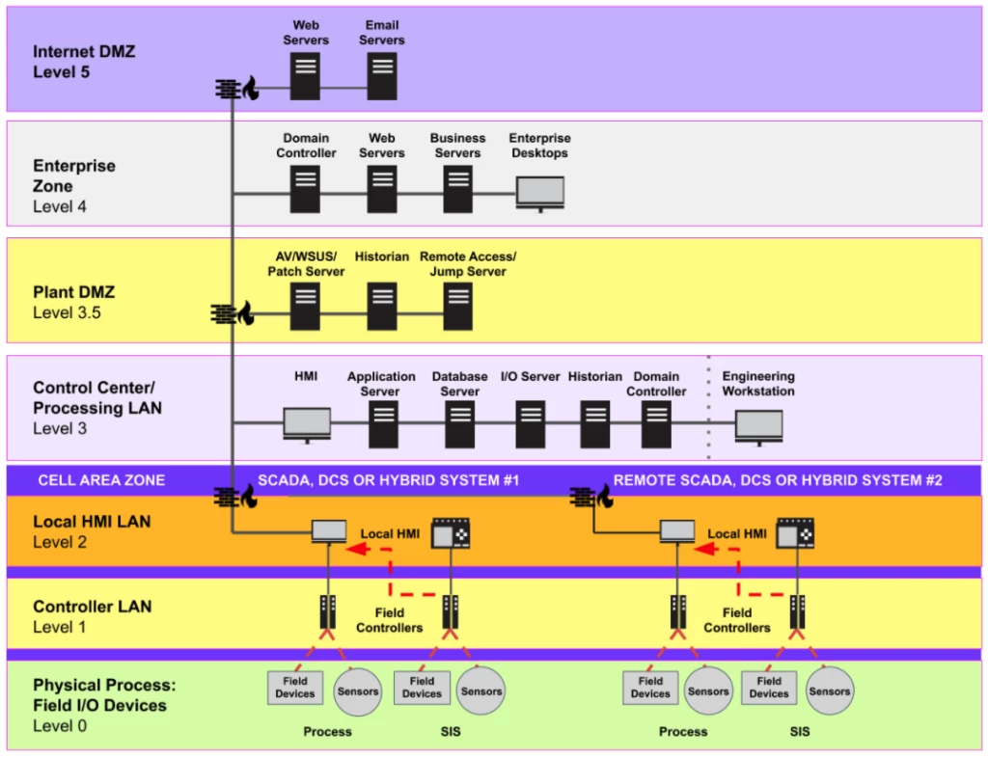

Slide 15
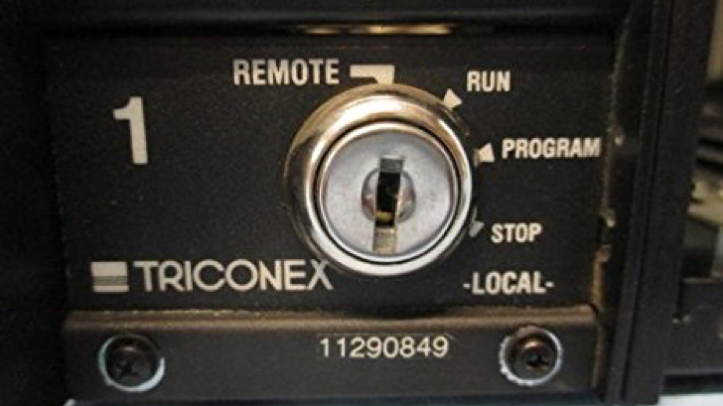
Anatomy Of A Complex OT Attack

Slide 16


Slide 17
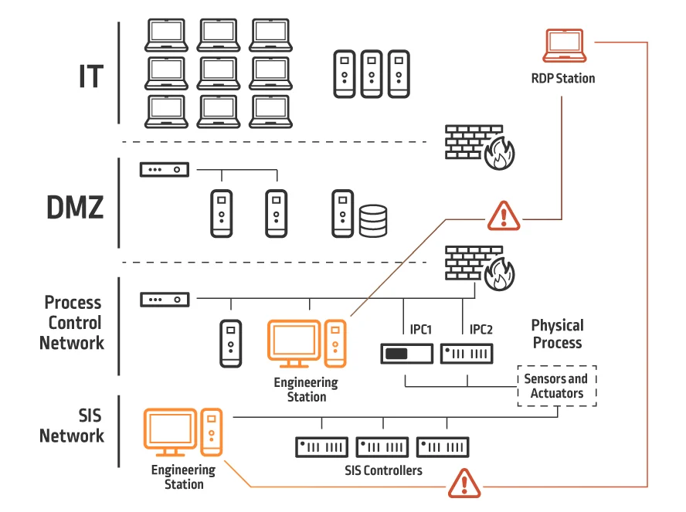
Inside The Victim Network

Slide 18
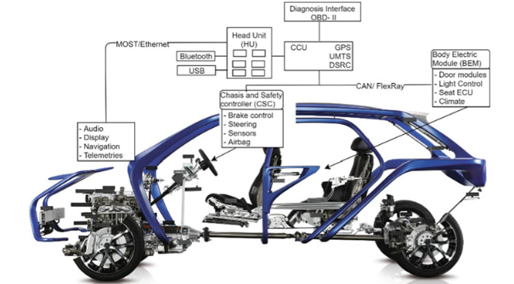
Separation of Duties
Notes:
We need to keep devices with higher levels of privilege in a special area of the network. We can’t just lump everything together. Let’s take a look at this breakdown of the network inside of a car and see how this applies.

Slide 19
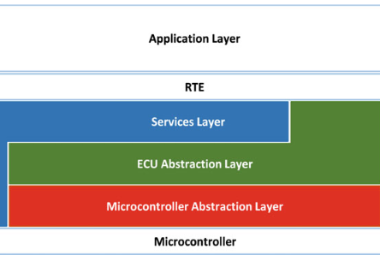
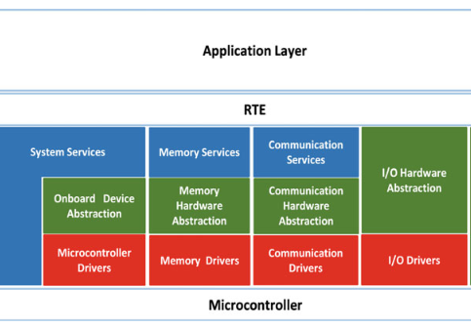
Separation of Software Components

Slide 20
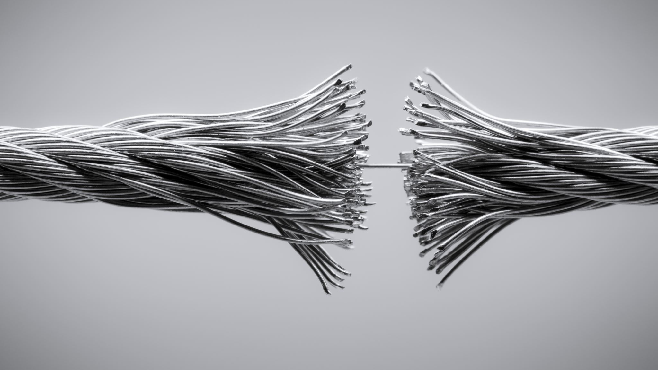
Air Gapped Networks

Slide 21
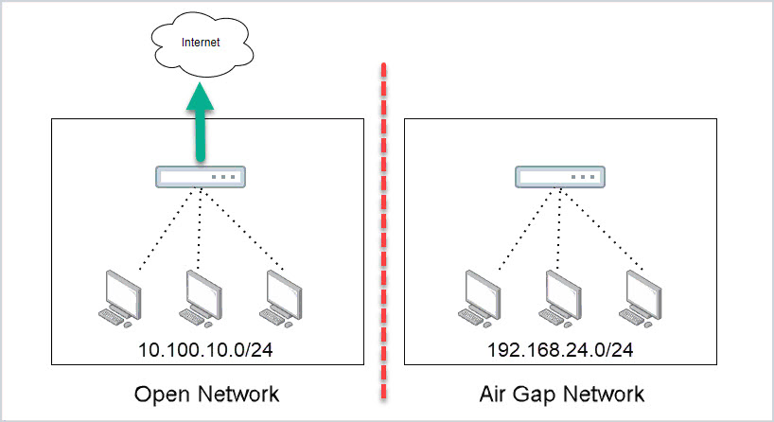
Air Gapped Networks
Notes:
How realistic is this?

Slide 22
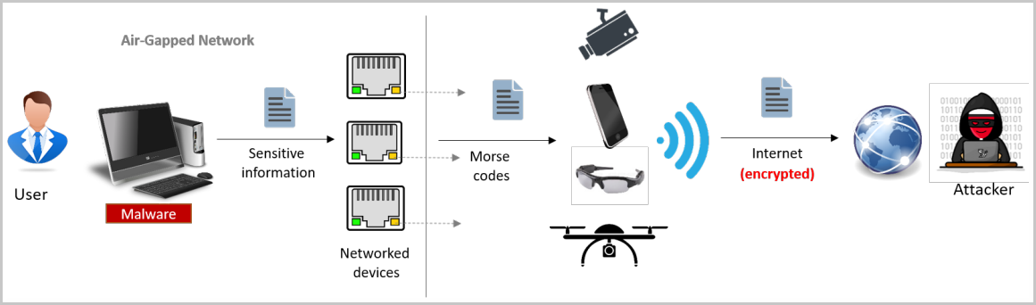
An Interesting Attack
Notes:
Malware on an air-grapped network produces a flash on the network card that can be seen by a camera, maybe attached to a drone of some kind, the flash can then be sent via the internet to an attacker.

Slide 23
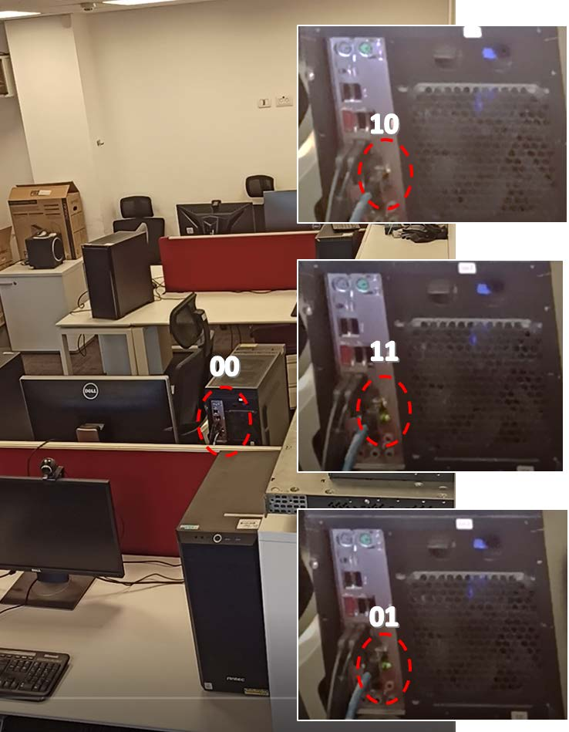
Notes:
Here we can see the lights blinking in a two-bit sequence at a time. Two lights on the network card indicate 4 different states of binary.

Slide 24
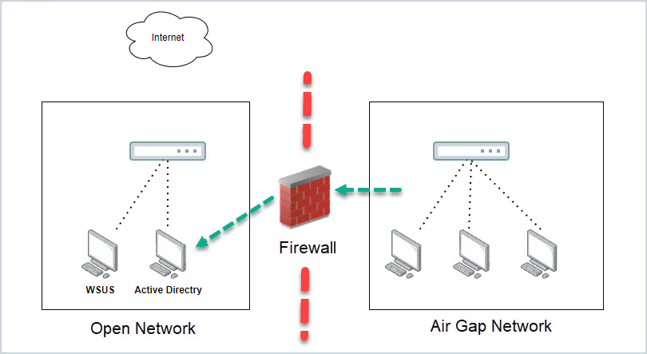
Is This An Airgap?
Notes:
What do we think about this network though? Is this an airgap? So what is the ideal network footprint?

Slide 25
Is There A Point To Air Gapping?
Notes:
Given everything we’ve just talked about, is there any point to working an air gap into a network?

Slide 26


10 minute break

Slide 27

What Does Separation Mean For Development?
Notes:
We need to make sure we’re tracking the changes in the way our networks are built so that we can properly code around it. What does it mean when we make a change to our network architecture that effects our update distribution system?

Slide 28
How Does Software Fit In?

Slide 29

Can This Apply To Cars?
Notes:
Can this same concept apply to cars? Of course it can!

Slide 30
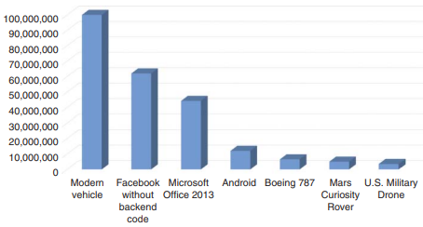
Software By Lines Of Code
Notes:
But when we apply the concept of separation of duties to cars, we have to understand what we’re dealing with. By lines of code, modern cars are among the most complexly coded devices around.

Slide 31
Controller Area Network (CAN)

Slide 32
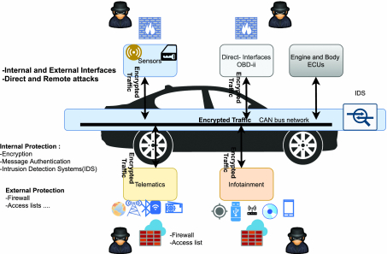
Controller Area Network
Notes:
CAN bus devices operate in an interconnected fashion, very similar to how we build computer networks. Controller devices produce information, and we transfer that information over a local area network that we call the CAN or Controller Area Network. That information is packaged in a way similar to the way we package network packets – we saw this last week.

Slide 33
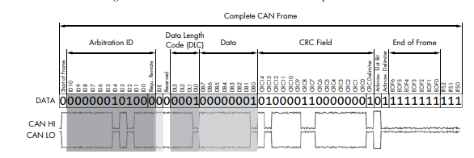
Notes:
This should look at least somewhat similar. The amount of information we’re talking about here is considerably less in CANbus traffic than it is in network packets. It has to be lean because we’re talking about controls that literally make the car move in real time. What you’ll notice about this frame is that there’s nothing here that provides any degree of security.

Slide 34
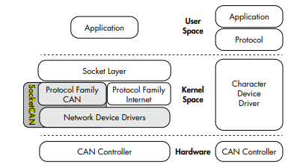
SocketCAN
Notes:
CAN = Controller Area Network
On the right is the CAN, on the left is socketCAN, a newer implementation of the CANbus

Slide 35

Where’s the Security??
Notes:
There’s very little security on the CANbus, but what security does exist is built into session establishment. The thinking is that we don’t necessarily need to build in security because historically, we could access the CANbus directly, and exclusively through an ODB-II reader. But now we have cars being added to wide area networks through a network connection, so there are more ways of accessing cars now.

Slide 36

Secure Booting

Slide 37
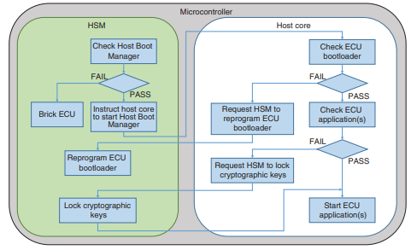
Vehicle Secure Boot
Notes:
In this image we have two main parts of the boot microcontroller, the Hardware Security Model (HSM) and the host core. The role of the HSM is to run through the entirety of the system’s memory before allowing the system to boot. The first thing the HSM does is scans a small part of the system’s memory called the host boot manager. Only when all of the integrity checks pass will the HSM allow the vehicle to boot.

Slide 38
Additional Protocols In Use
ISO-TP
A.K.A. ISO 15765-2
CANopen
GMLAN
Notes:
A few protocols we might run into are open protocols like ISO-TP and CANopen, but because the community of auto manufacturers and suppliers overlaps so much, it’s likely that GMLAN will be used in more than one piece of software any given supplier may be working on.

Slide 39
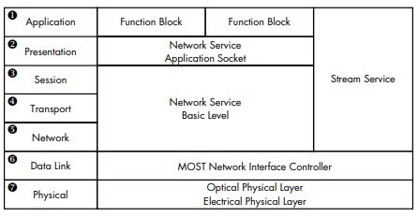
Vehicle Media Systems
Notes:
Vehicle media systems are a part of an interconnection of media devices we call MOST. MOST stands for Media Oriented Systems Transport. Does any part of this look familiar?

Slide 40
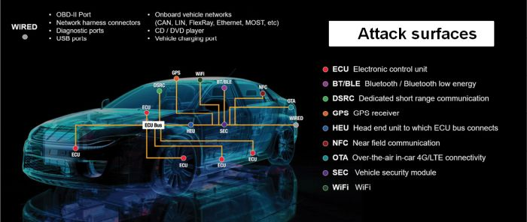
Car Software Attack Surface

Slide 41
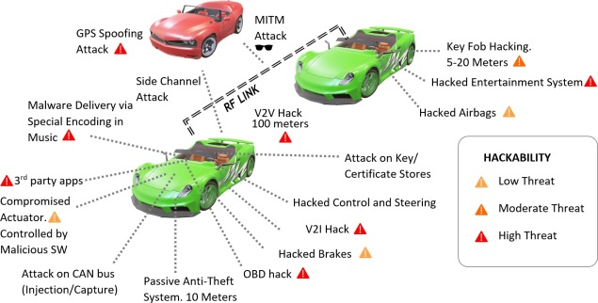
Popular Car Attack Surfaces

Slide 42
10 minute break

Slide 43
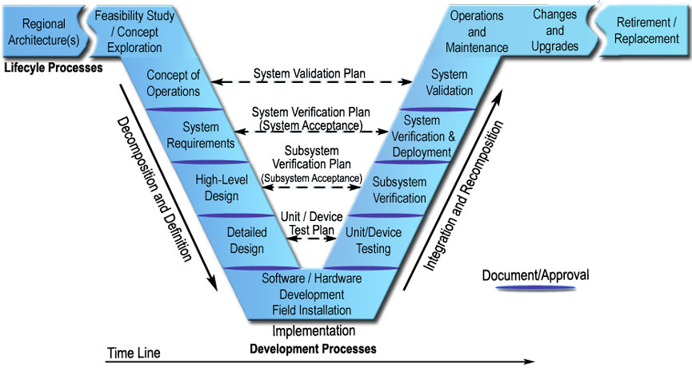
V-Model of Systems Engineering

Slide 44
Notes:
We need to talk about the V-model of engineering, which is a document we would have generated during our planning phase. The V-Model will span a space within our build cycle from planning to deployment, so let’s take a close look at this and see how this applies to our build effort. In past classes, we talked a bit about what a V-model might look like in terms of documentation, but we didn’t talk about how the documentation fits into a larger model of engineering design.

Slide 45
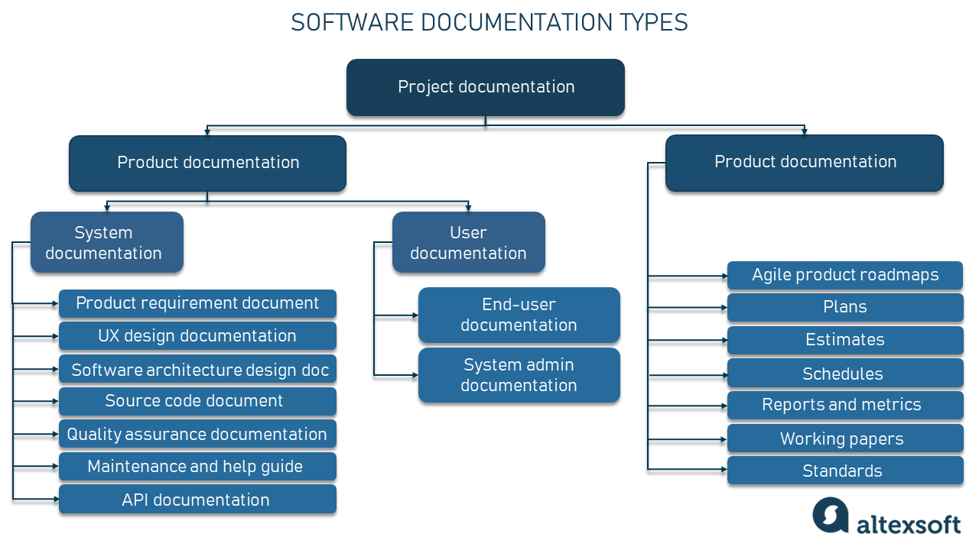
Site/Product Map
Notes:
Site/Product Map

Slide 46
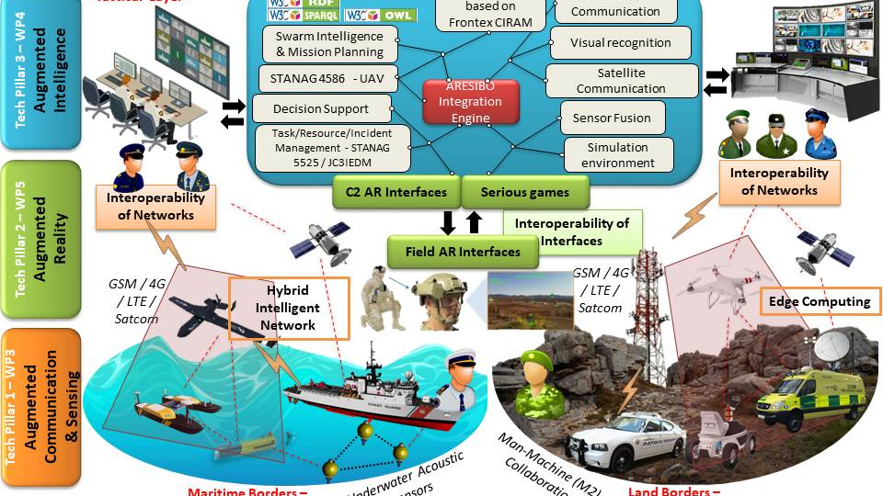
Notes:
This is a military CONOP

Slide 47
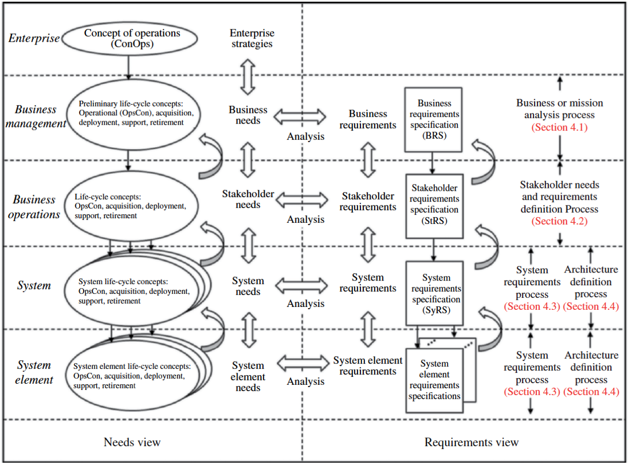
Concept of Operations (CONOP)
Notes:
In past classes, we talked a little about what a Conop is, but let’s see what a CONOP might look like. Here we can see what an example CONOP would look like. The CONOP is a 10,000 ft. view of how we will lay out our services, and how they may overlap and integrate with other services we need for our application.

Slide 48
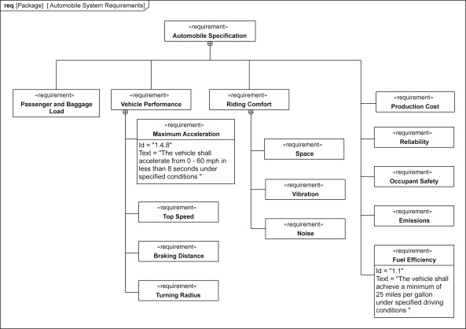
System Requirements Diagram

Slide 49
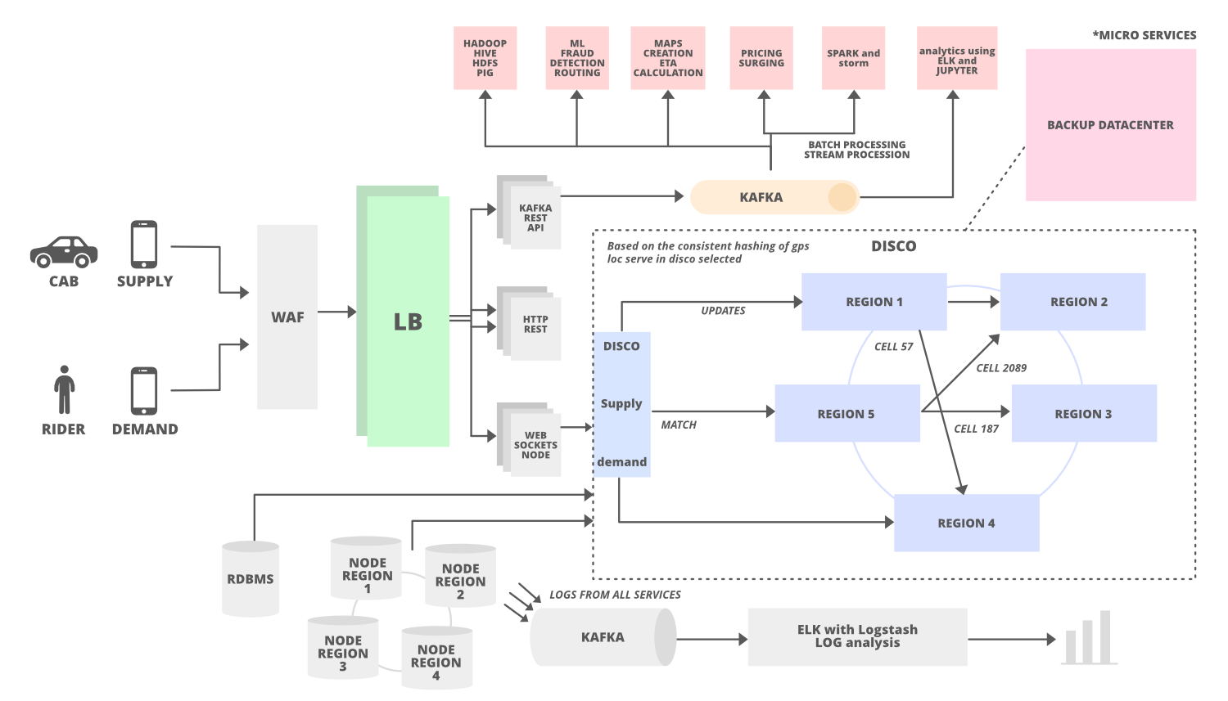
High-Level Design Documentation

Slide 50

Detailed Architecture Design Documentation
User flow diagram
Site/product map
User story map

Slide 51
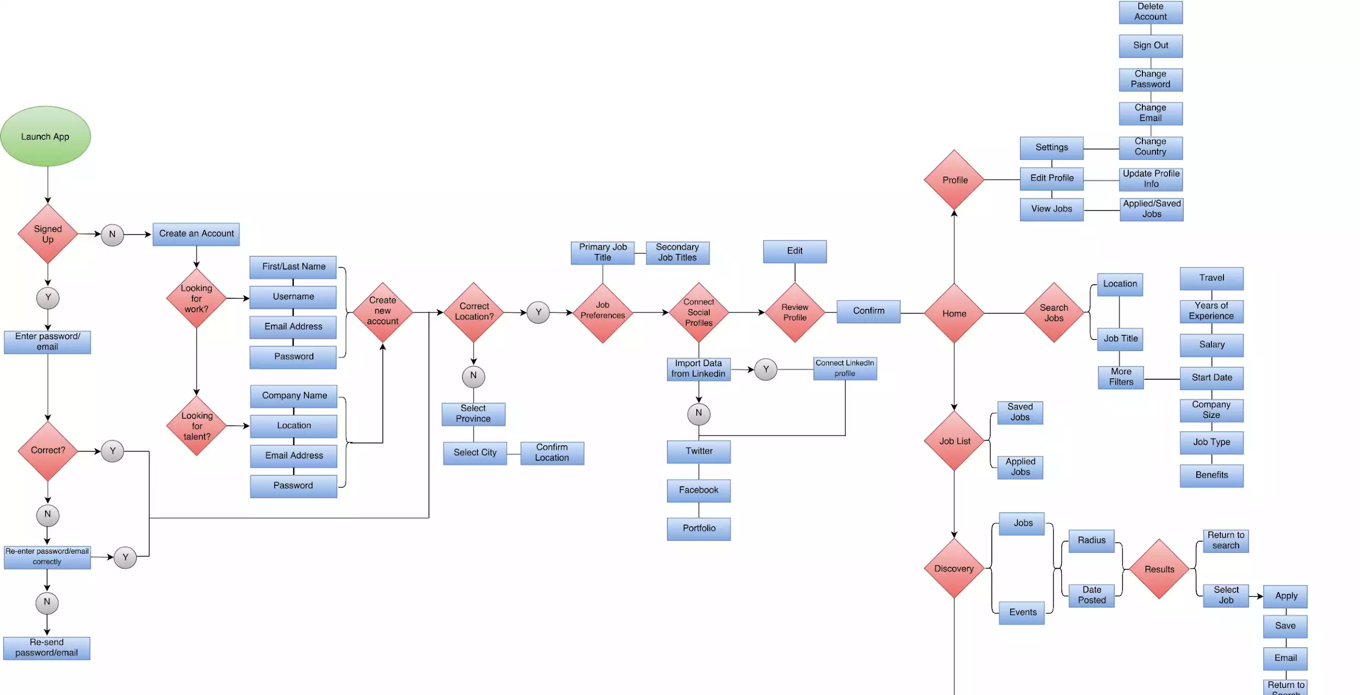
Notes:
This is a user flow diagram

Slide 52
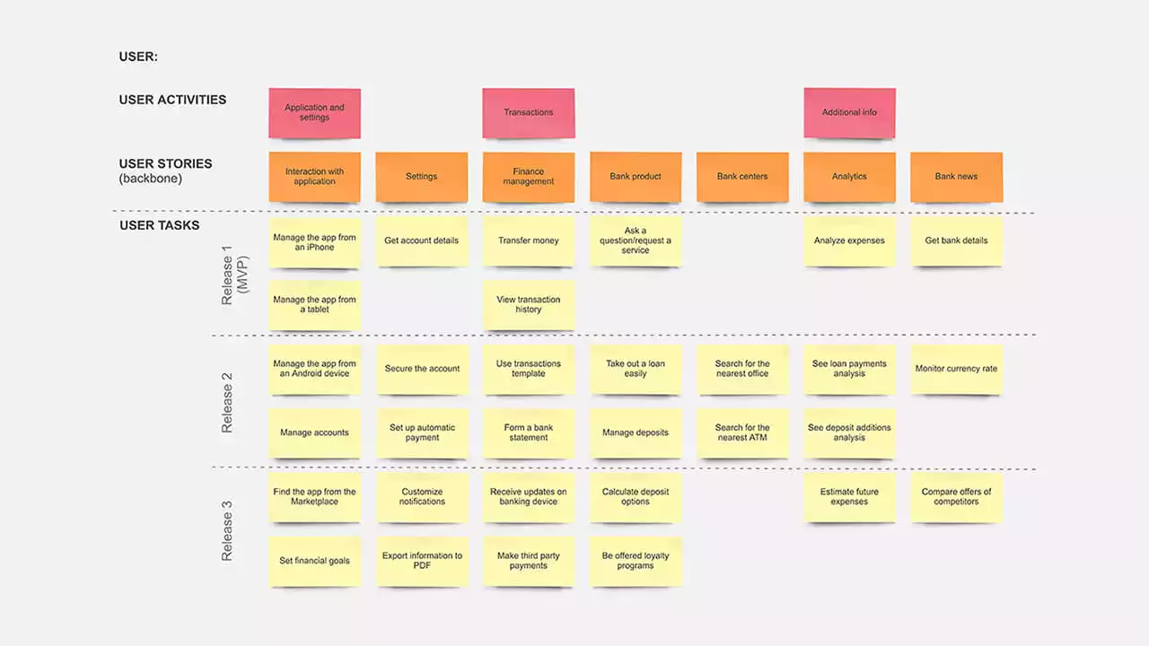
Notes:
This is a User Story Map example. Notice here that we have laid out things we want our program to do, and we’ve grouped those things by when we want to release them. Recognize that for the first release or what we call the MVP or “Minimum Viable Product”, we have fewer items than we do in Release 2. Why might that be?
The answer is that we will likely be constrained on what we will have time to work on before we release our product.

Slide 54
Operations & Maintenance

Slide 55
Automating Operations
Environment/Deployment Automation
Jenkins
Chef
Ansible
Pipeline building
Changes & upgrades
Can be easily done with automation scripting!

Slide 56
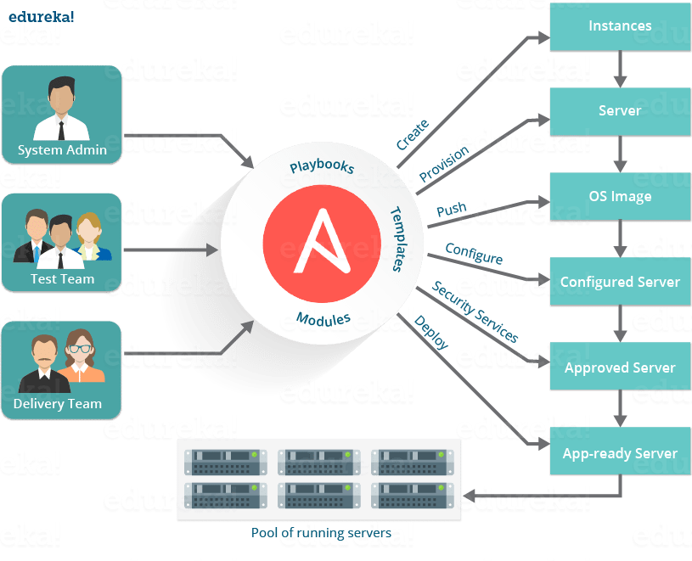

Slide 57

Retirement & Replacement
Notes:
The image is just here because I thought it was kind of funny. It’s what was suggested by the slide designer

Slide 58
End of life considerations
Can we actually afford to retire this system?
What will replace it?
Will this be transparent to users?
Where will new users go?

Slide 59
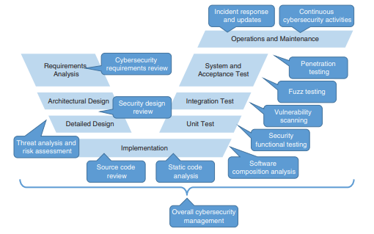
V-Model for Car Engineering

Slide 60

Risk Based Coding For Cars

Slide 61
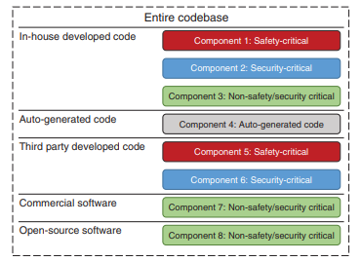
Categorize By Risk
Notes:
What we want to do here is separate our entire codebase by the amount of risk it presents.

Slide 62

References
The Car Hackers Handbook: A Guide For The Penetration Tester by Craig Smith

Slide 63

Question or clarifications?

Slide 64

Review Day 3

Slide 65

Preview Week 3

